Slide 1

FUNCTIONS, METHODS & OBJECTS

Slide 2
WHAT IS A FUNCTION?

Slide 3
Functions let you group a series of statements together to perform a specific task.

Slide 4
Functions are reusable and save you from writing out the same code over and over.

Slide 5
DECLARING A FUNCTION

Slide 6
function

Slide 7
function sayHello()

Slide 8
function sayHello() {
document.write(‘Hello’);
}

Slide 9
function sayHello() {
document.write(‘Hello’);
}
KEYWORD

Slide 10
function sayHello() {
document.write(‘Hello’);
}
FUNCTION NAME

Slide 11
function sayHello() {
document.write(‘Hello’);
}
CODE BLOCK (IN CURLY BRACES)

Slide 12
CALLING A FUNCTION

Slide 13
sayHello();

Slide 14
sayHello();
FUNCTION NAME

Slide 15
DECLARING A FUNCTION THAT NEEDS INFORMATION

Slide 16
function

Slide 17
function getArea()

Slide 18
function getArea(width, height)

Slide 19
function getArea(width, height) {
return width * height;
}

Slide 20
function getArea(width, height) {
return width * height;
}
PARAMETER
PARAMETER

Slide 21
function getArea(width, height) {
return width * height;
}
THE PARAMETERS ARE USED LIKE VARIABLES WITHIN THE FUNCTION

Slide 22
CALLING A FUNCTION THAT NEEDS INFORMATION

Slide 23
getArea(3, 5);

Slide 24
getArea(3, 5);
ARGUMENTS

Slide 25
OBJECTS

Slide 26
Objects group together variables and functions to create a model.

Slide 27
In an object, variables and functions take on new names. They become properties and methods.

Slide 28
Each property or method consists of a name (also known as a key) and its corresponding value.

Slide 29
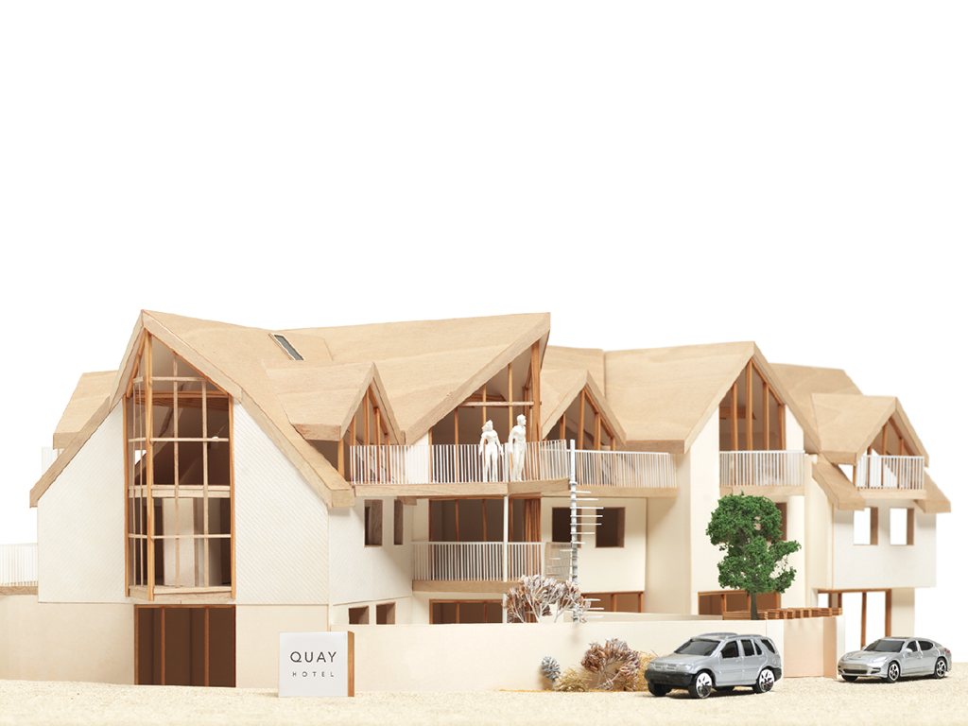
var hotel = {
name: ‘Quay’,
rooms: 40,
booked: 25,
gym: true,
roomTypes: [‘twin’, ‘double’, ‘suite’],
checkAvailability: function() {
return this.rooms - this.booked;
}
};

Slide 30
var hotel = {
name: ‘Quay’,
rooms: 40,
booked: 25,
gym: true,
roomTypes: [‘twin’, ‘double’, ‘suite’],
checkAvailability: function() {
return this.rooms - this.booked;
}
};

Slide 31
NAMES (KEYS)
var hotel = {
name: ‘Quay’,
rooms: 40,
booked: 25,
gym: true,
roomTypes: [‘twin’, ‘double’, ‘suite’],
checkAvailability: function() {
return this.rooms - this.booked;
}
};

Slide 32
VALUES
var hotel = {
name: ‘Quay’,
rooms: 40,
booked: 25,
gym: true,
roomTypes: [‘twin’, ‘double’, ‘suite’],
checkAvailability: function() {
return this.rooms - this.booked;
}
};

Slide 33
PROPERTIES
var hotel = {
name: ‘Quay’,
rooms: 40,
booked: 25,
gym: true,
roomTypes: [‘twin’, ‘double’, ‘suite’],
checkAvailability: function() {
return this.rooms - this.booked;
}
};

Slide 34
METHOD
var hotel = {
name: ‘Quay’,
rooms: 40,
booked: 25,
gym: true,
roomTypes: [‘twin’, ‘double’, ‘suite’],
checkAvailability: function() {
return this.rooms - this.booked;
}
};

Slide 35
ACCESSING OBJECTS

Slide 36
var hotelName = hotel.name;

Slide 37
var hotelName = hotel.name;
OBJECT

Slide 38
var hotelName = hotel.name;
PROPERTY

Slide 39
var hotelName = hotel[‘name’];

Slide 40
var hotelName = hotel[‘name’];
OBJECT

Slide 41
var hotelName = hotel[‘name’];
PROPERTY

Slide 42
UPDATING OBJECTS

Slide 43
hotel.name = ‘Park’;

Slide 44
hotel.name = ‘Park’;
OBJECT

Slide 45
hotel.name = ‘Park’;
PROPERTY

Slide 46
hotel.name = ‘Park’;
NEW VALUE

Slide 47
hotel[‘name’] = ‘Park’;

Slide 48
hotel[‘name’] = ‘Park’;
OBJECT

Slide 49
hotel[‘name’] = ‘Park’;
PROPERTY

Slide 50
hotel[‘name’] = ‘Park’;
NEW VALUE

Slide 51
BUILT-IN OBJECTS

Slide 52
1

Slide 53
1
Browser Object Model
THE WEB BROWSER

Slide 54
BROWSER OBJECT MODEL
PROPERTIES INCLUDE:
window.innerHeight
window.innerWidth
window.screenX
window.screenY
METHODS INCLUDE:
window.print()

Slide 55
2
1
Browser Object Model
THE WEB BROWSER

Slide 56
1
2
Browser Object Model
THE WEB BROWSER
Document Object Model
THE PAGE LOADED IN THE WEB BROWSER (OR TAB)

Slide 57
DOCUMENT OBJECT MODEL
PROPERTIES INCLUDE:
document.title
document.lastModified
METHODS INCLUDE:
document.write()
document.getElementById()

Slide 58
3
1
2
Browser Object Model
THE WEB BROWSER
Document Object Model
THE PAGE LOADED IN THE WEB BROWSER (OR TAB)

Slide 59
1
2
3
Browser Object Model
THE WEB BROWSER
Document Object Model
THE PAGE LOADED IN THE WEB BROWSER (OR TAB)
Global JavaScript Objects
GENERAL PURPOSE OBJECTS JAVASCRIPT NEEDS TO WORK

Slide 60
GLOBAL JAVASCRIPT OBJECTS
PROPERTIES INCLUDE:
saying.length
METHODS INCLUDE:
saying.toUpperCase()
saying.toLowerCase()
saying.charAt(3)

